Slide 1

My Dream Company
Apple

Slide 2

Vision :
Making Great products
Focusing on innovating
Believing in deep collaboration and cross pollination
Believing in the simple not the complex
Admitting wrong and the courage to change
Making a significant contribution

Slide 3
Mission :
Designs Macs, OS X, iLife, iWork and professional software
Bringing music revolution
Reinventing the mobile phone
Defining the future

Slide 4
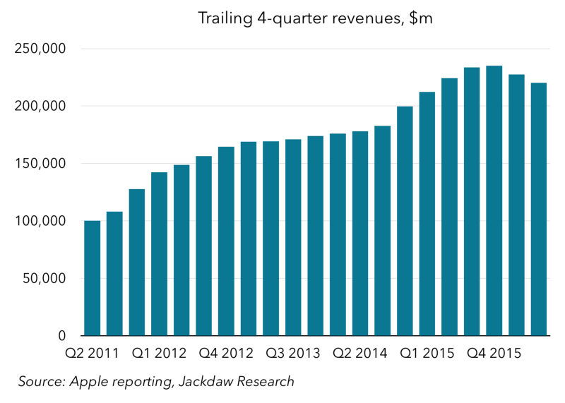
Growth :

Slide 5
Milestones :
launch of Apple II
25 billionth purchased song
50 billionth downloaded application
500 millionth iPhone
one-billionth iOS device
privacy grounds: Apple vs. FBI

Slide 6
Achievements :
Brand of the Year
Tech Emmy Award
Apple Design Awards/Human Interface Design Excellence (HIDE) Awards
Fastest-selling PC in history
Leading company in the field of technology
National medal

Slide 7
Corporate culture:
Ruthless
Self-motivated individuals
Decision making in the hand of the people
Confusing but delightful
Brutal and unforgiving
Directly responsible individual
Simplicity breeds clarity
Specialization is the norm at Apple
Self Esteem and Self Efficiency
DDADTTTI

